Slide 1
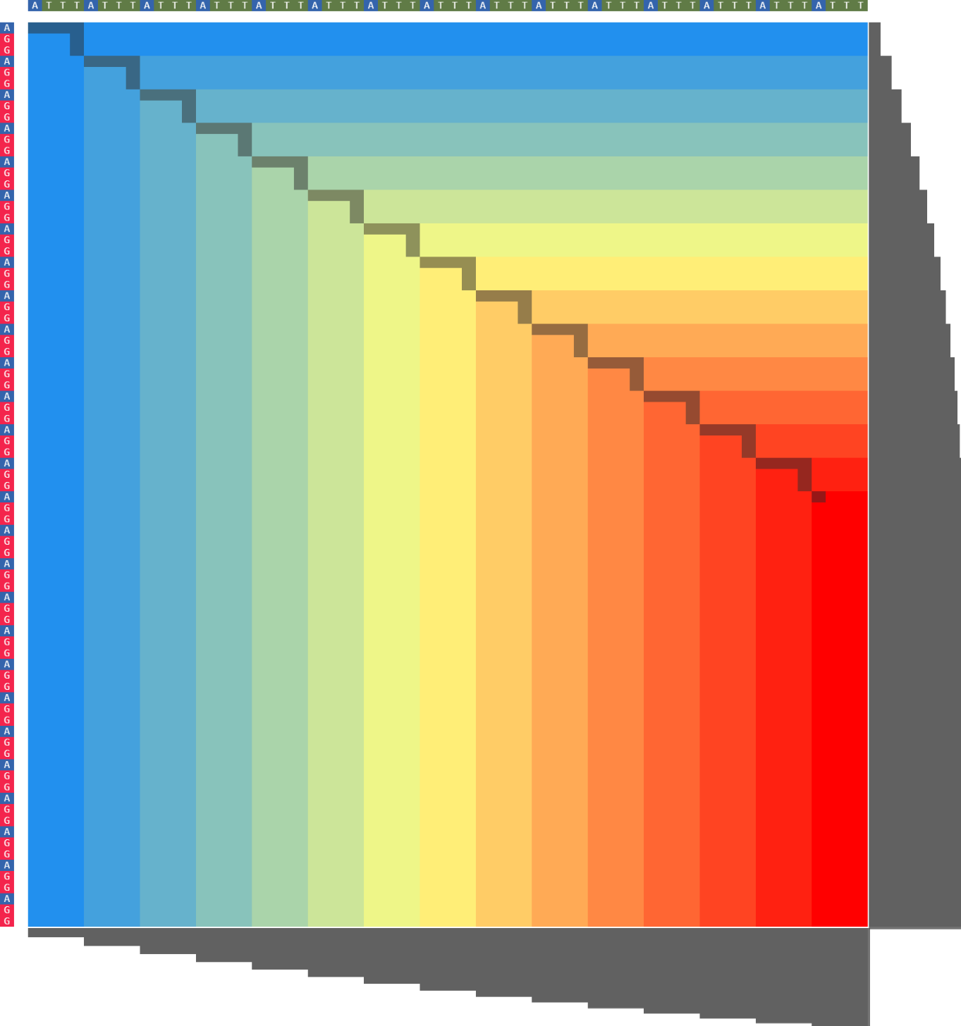
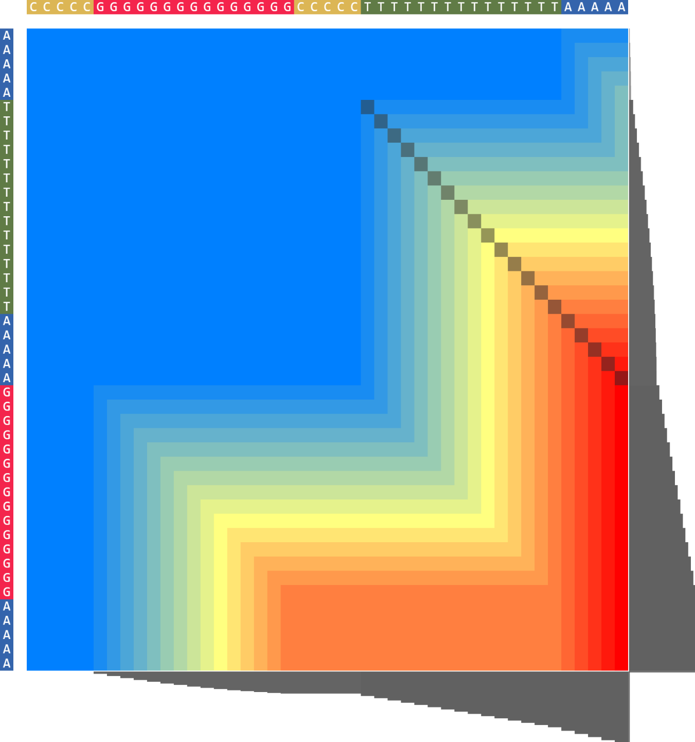
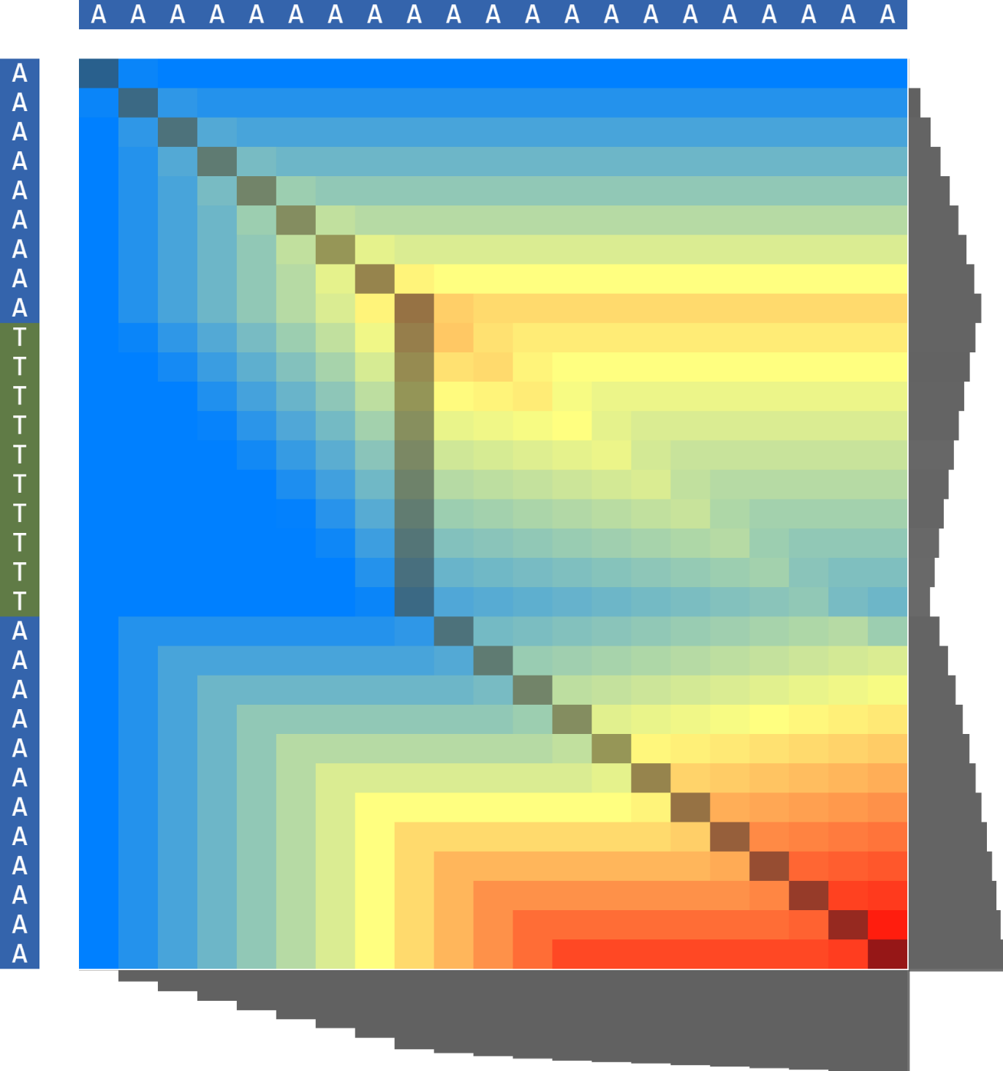
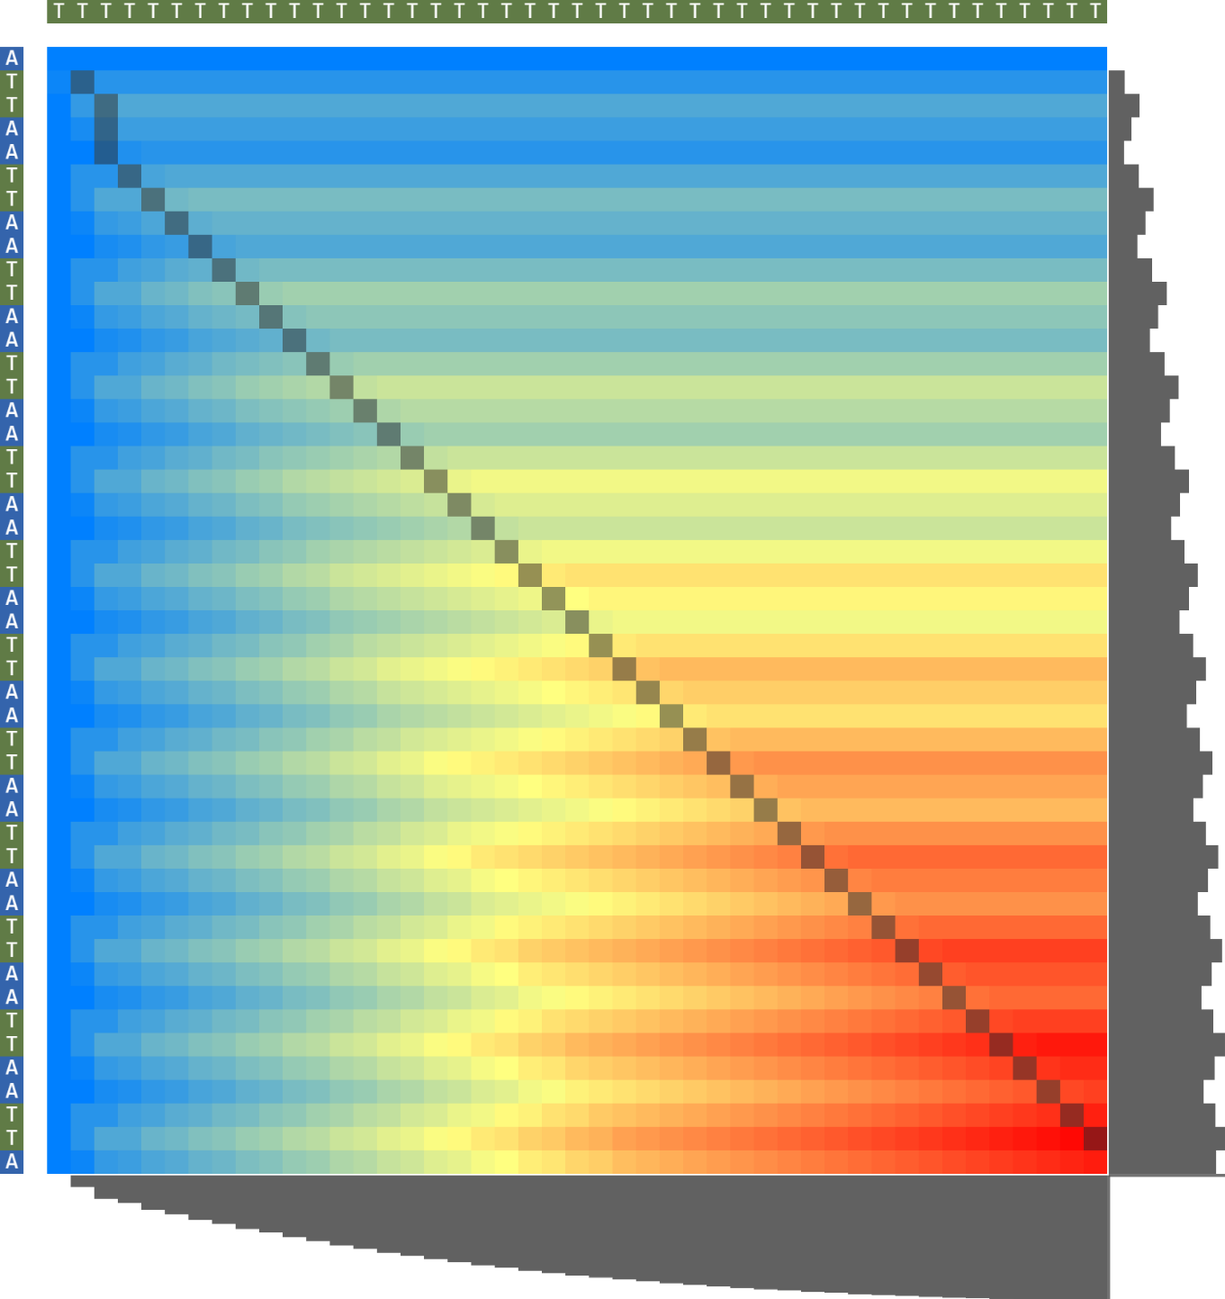
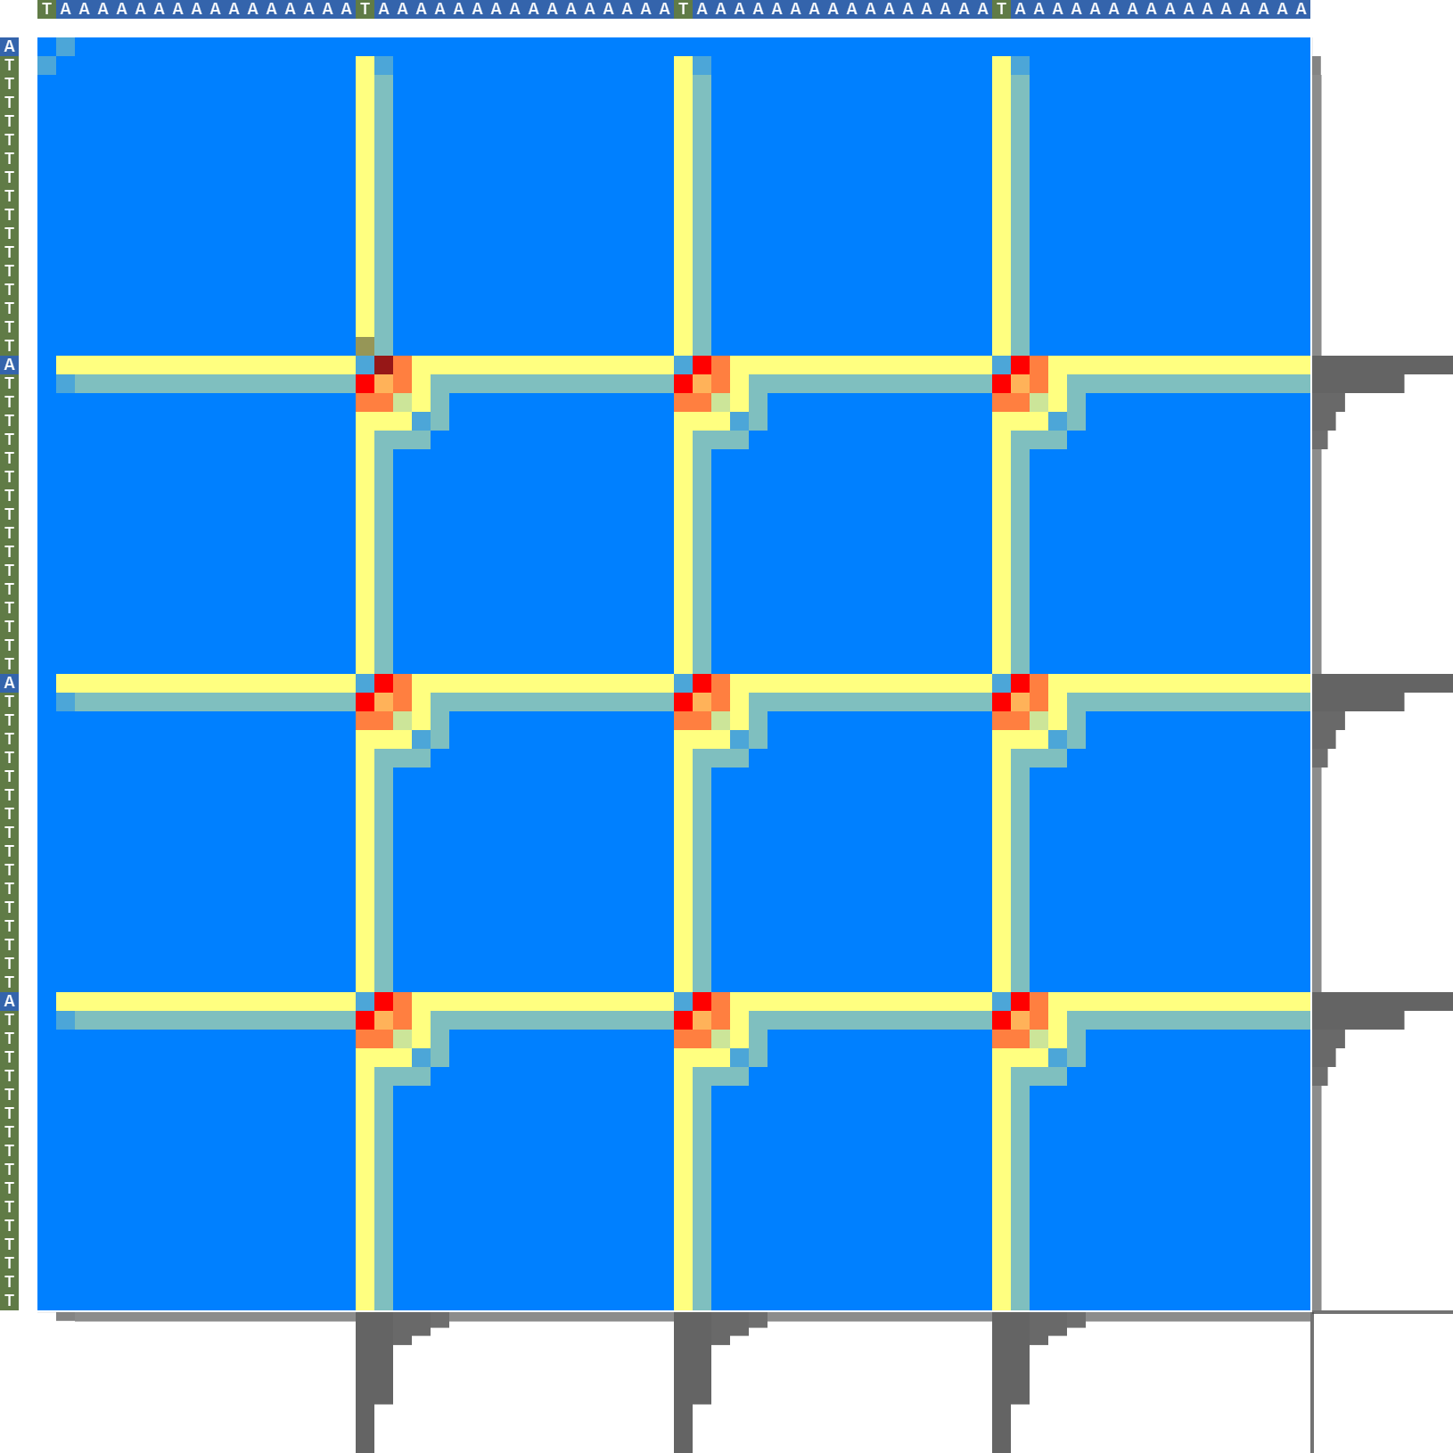
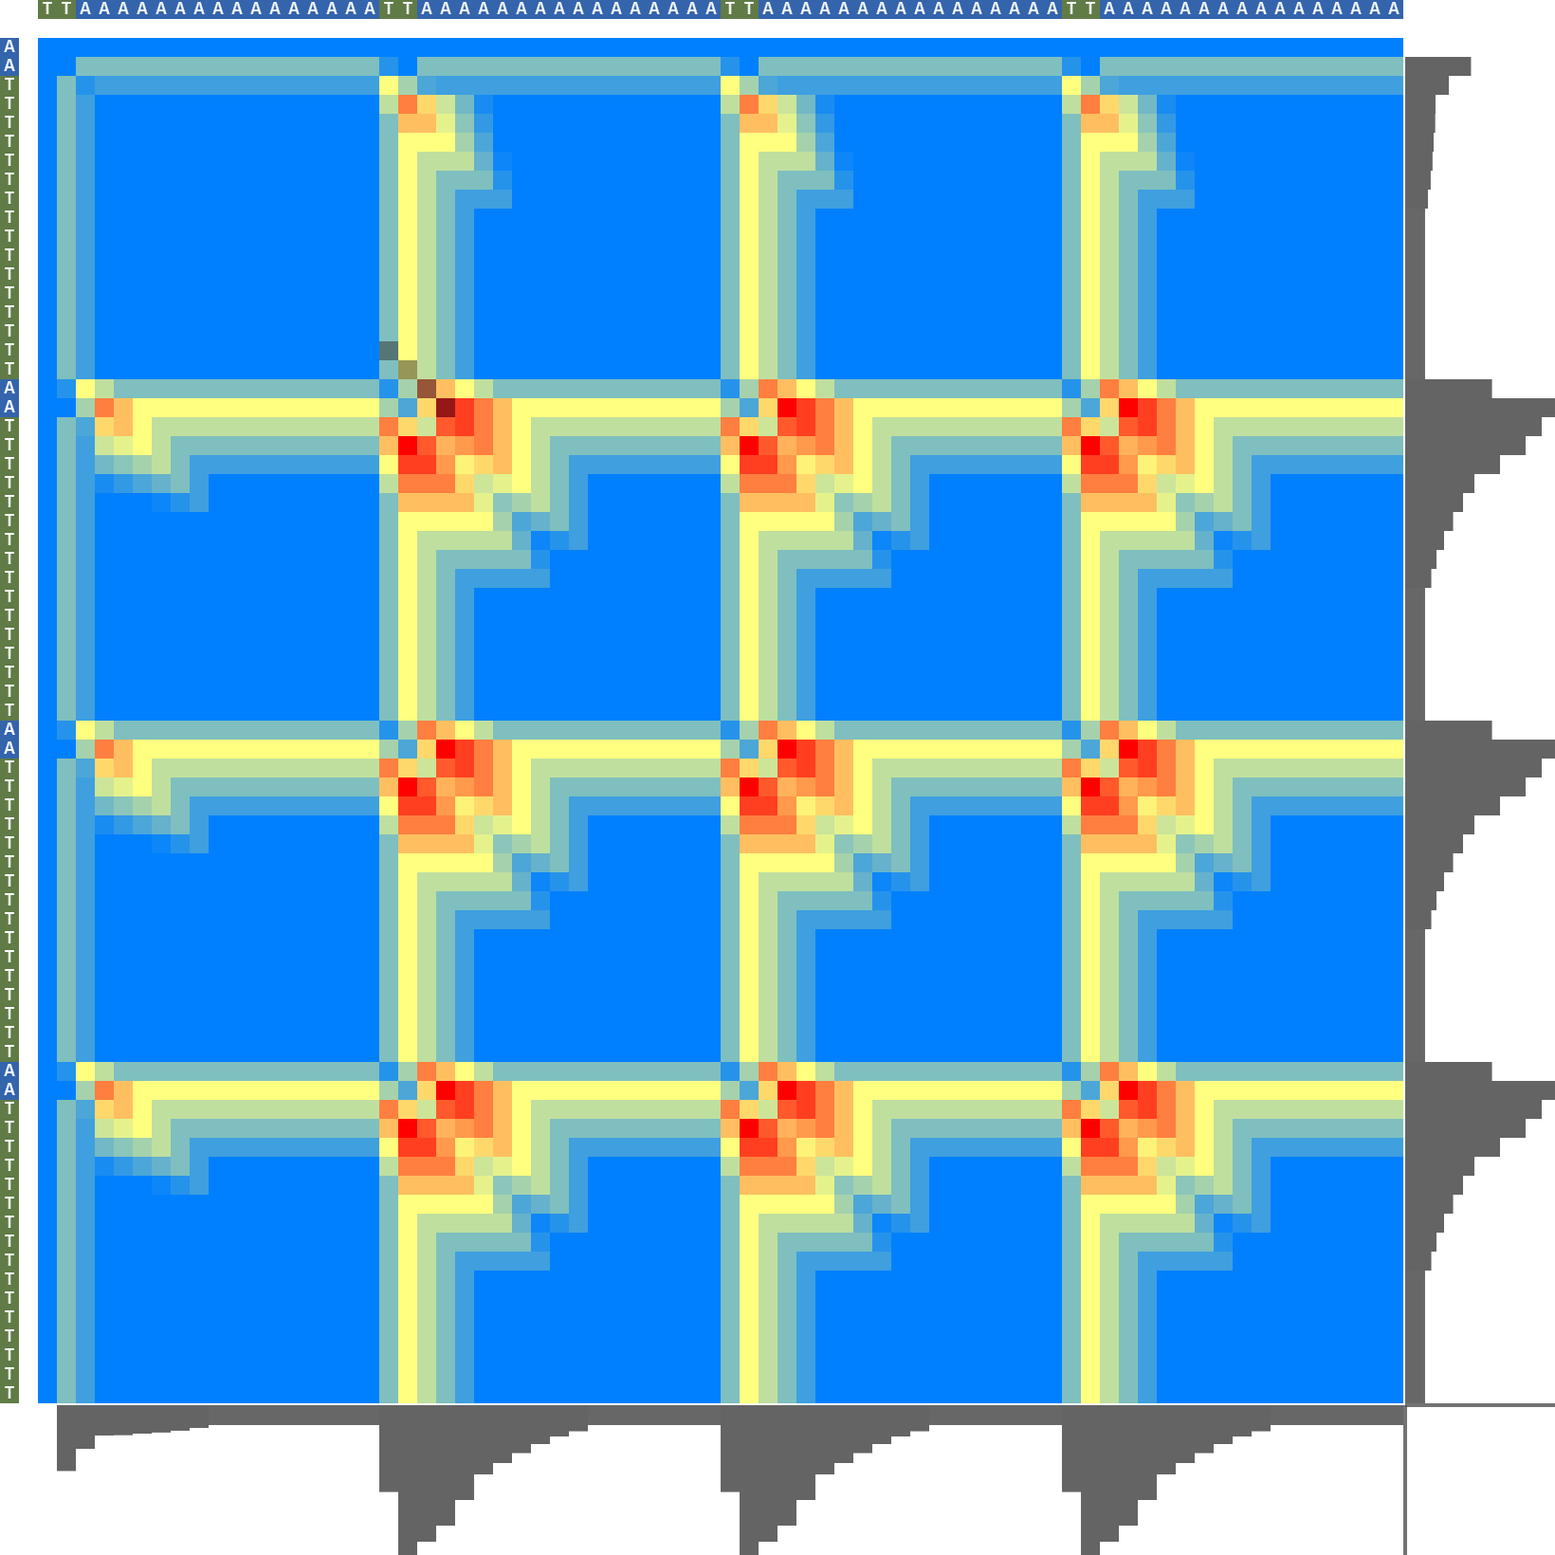
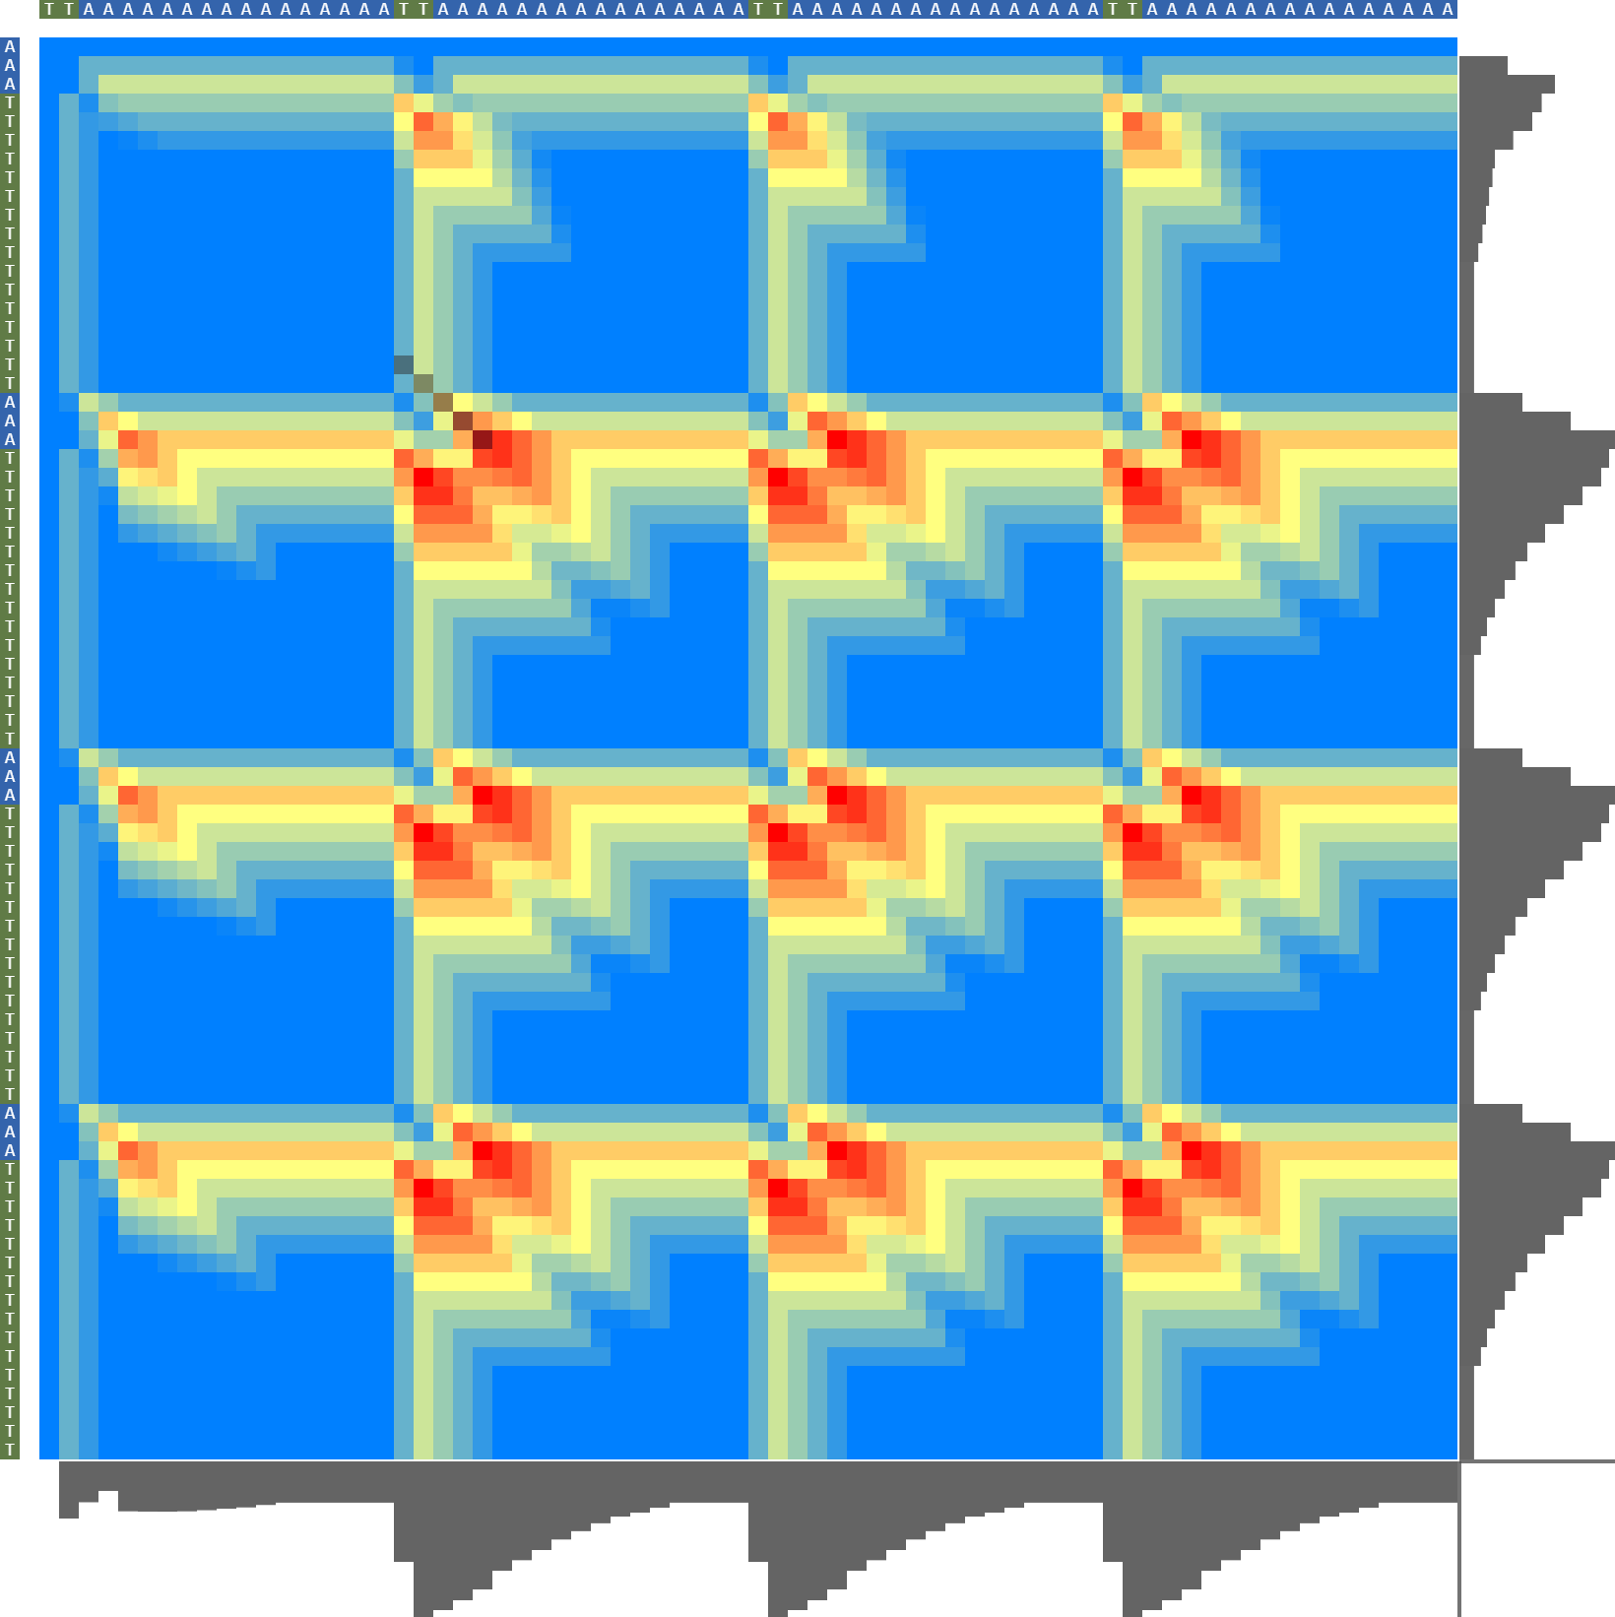
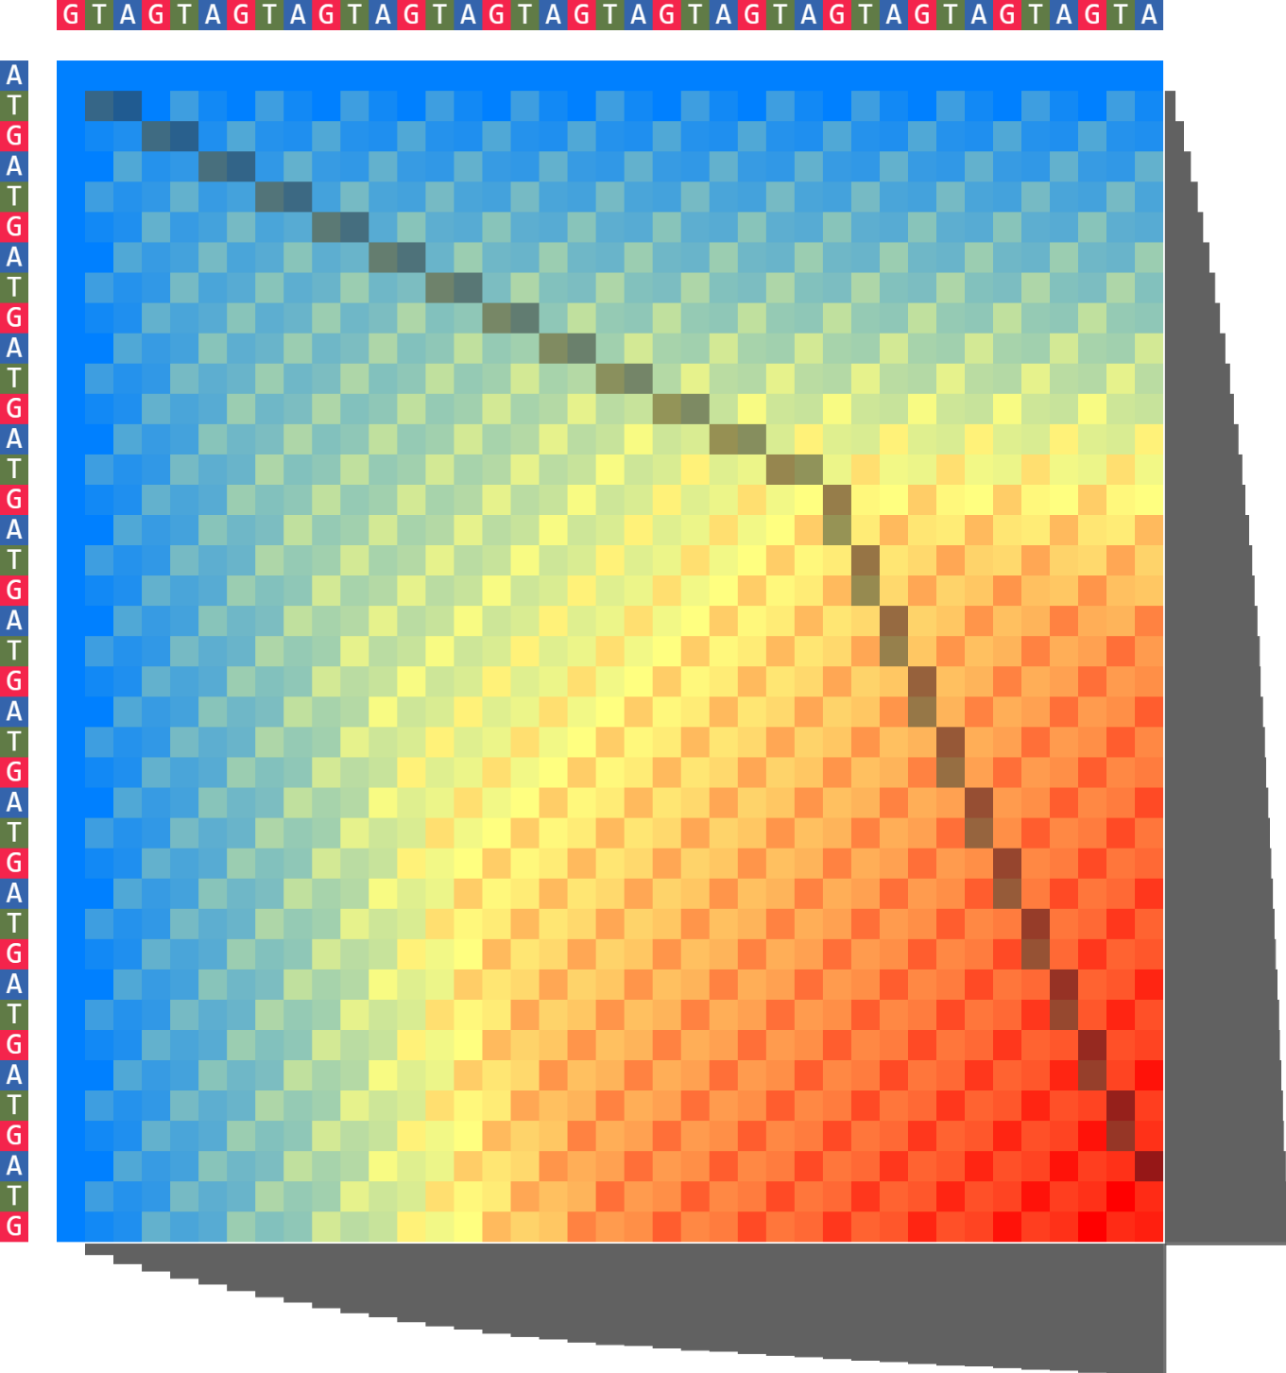
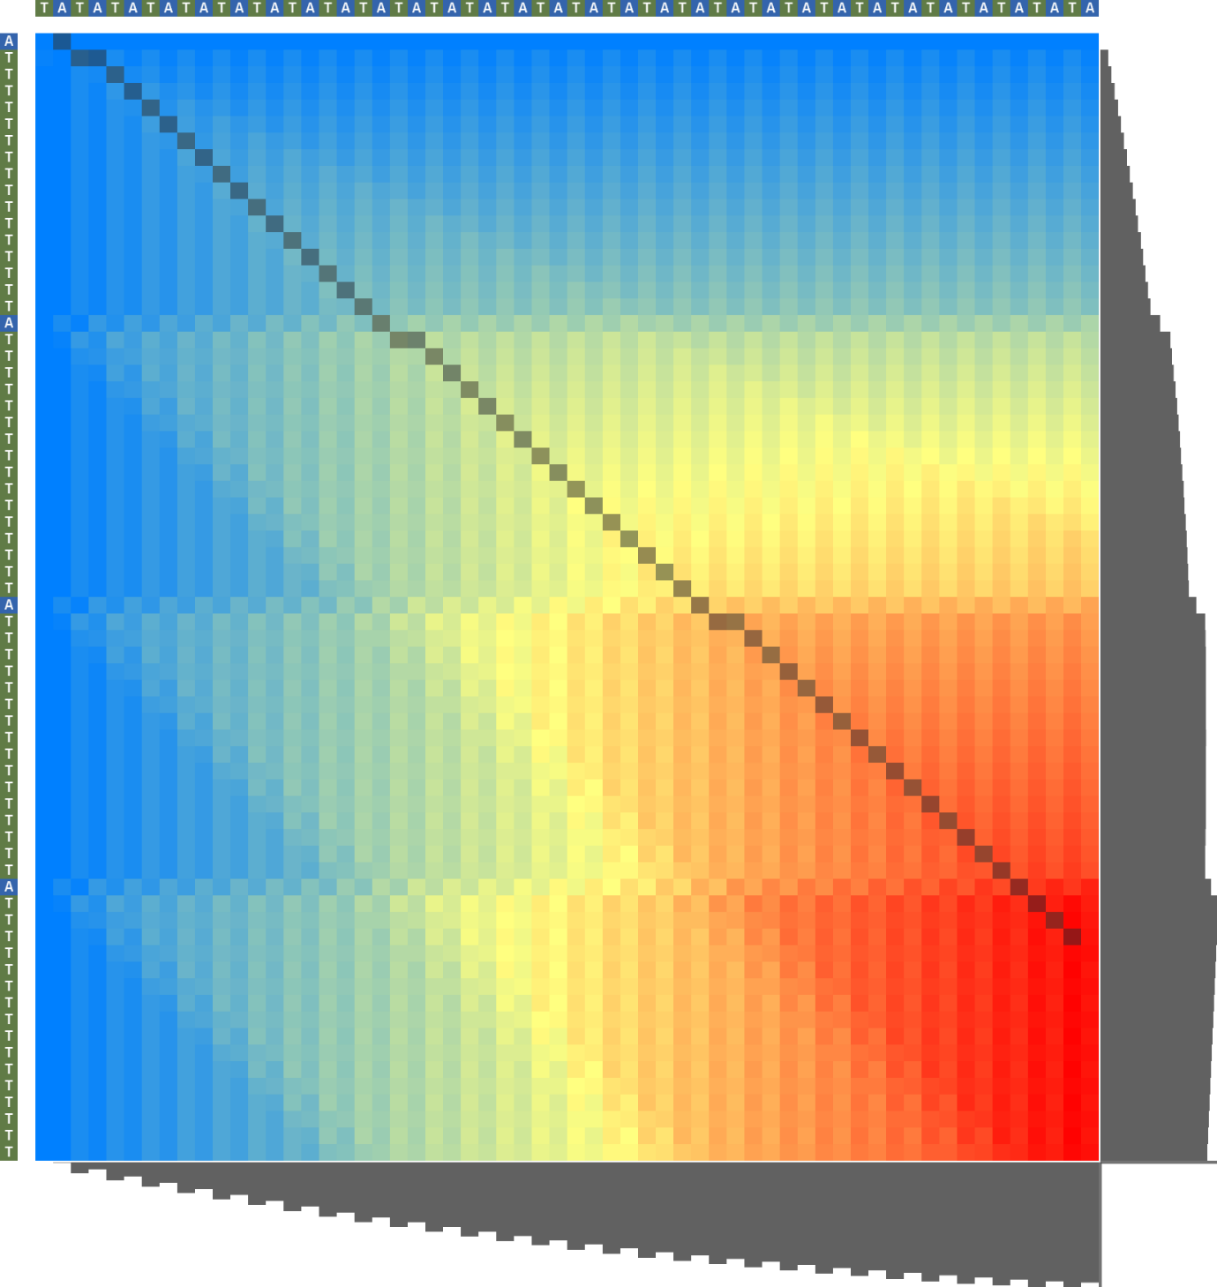
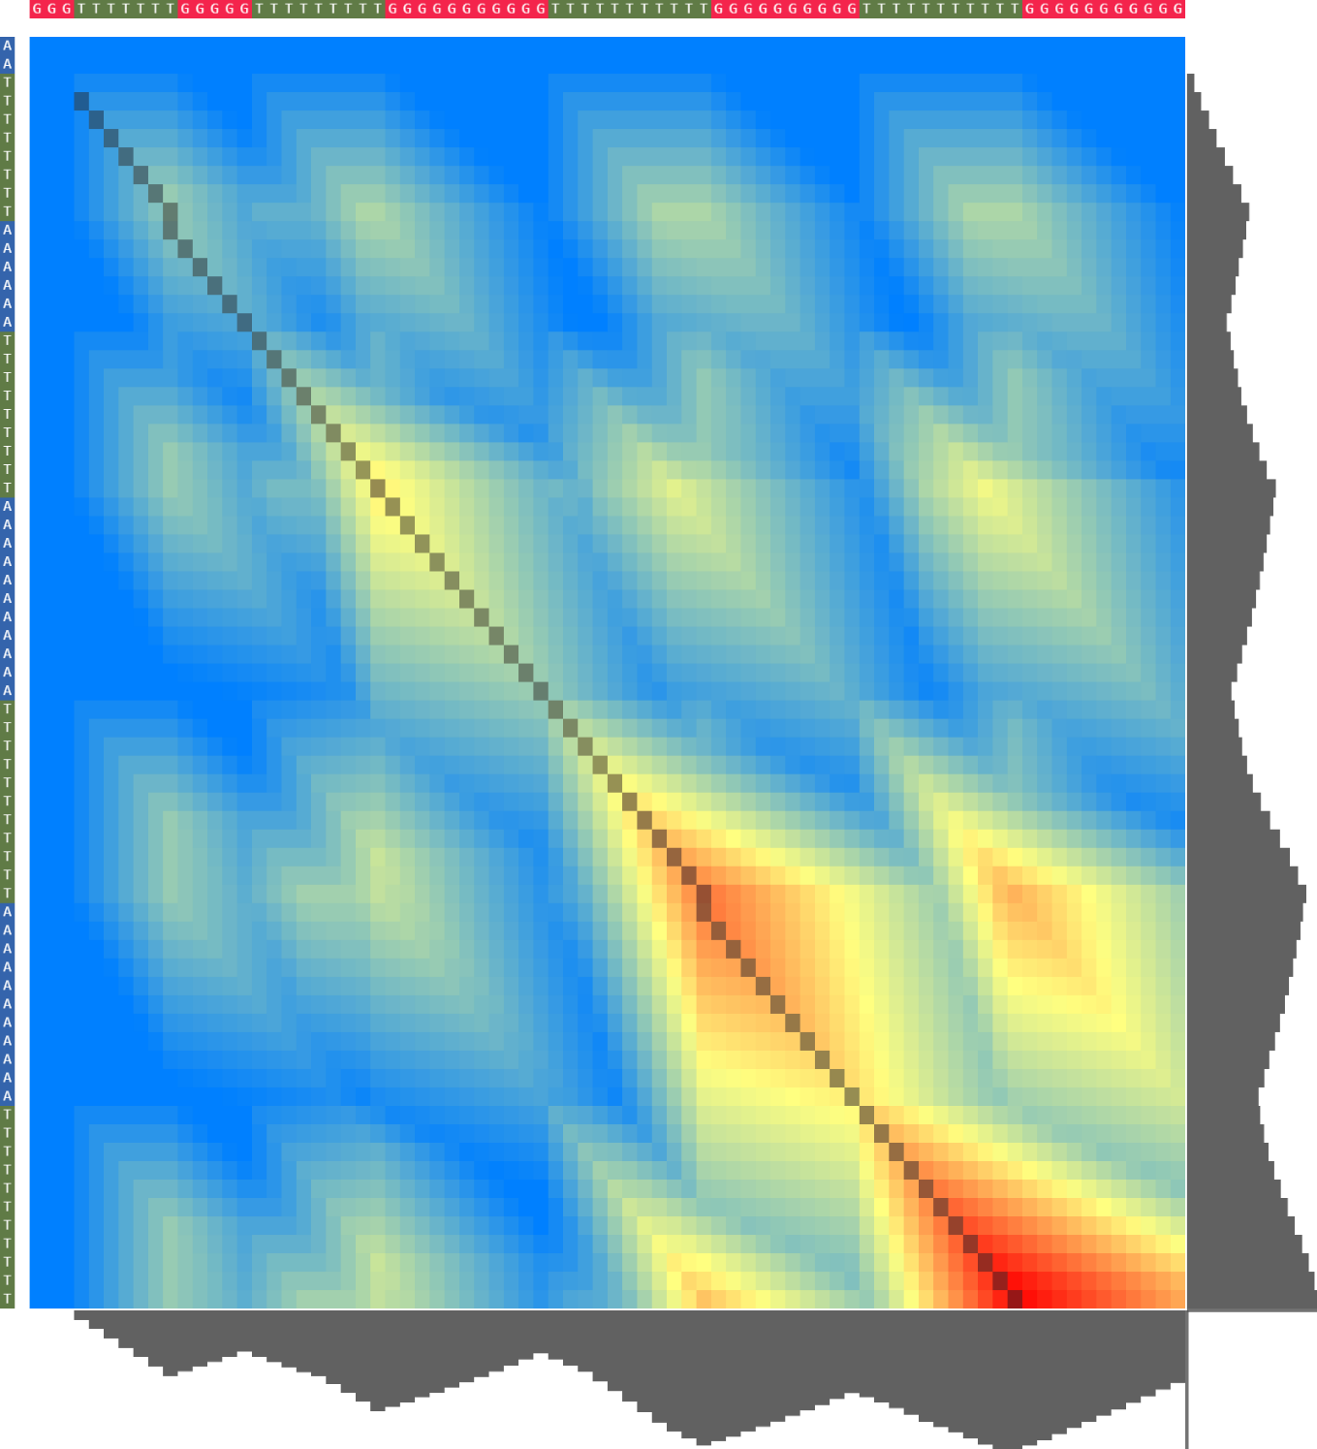
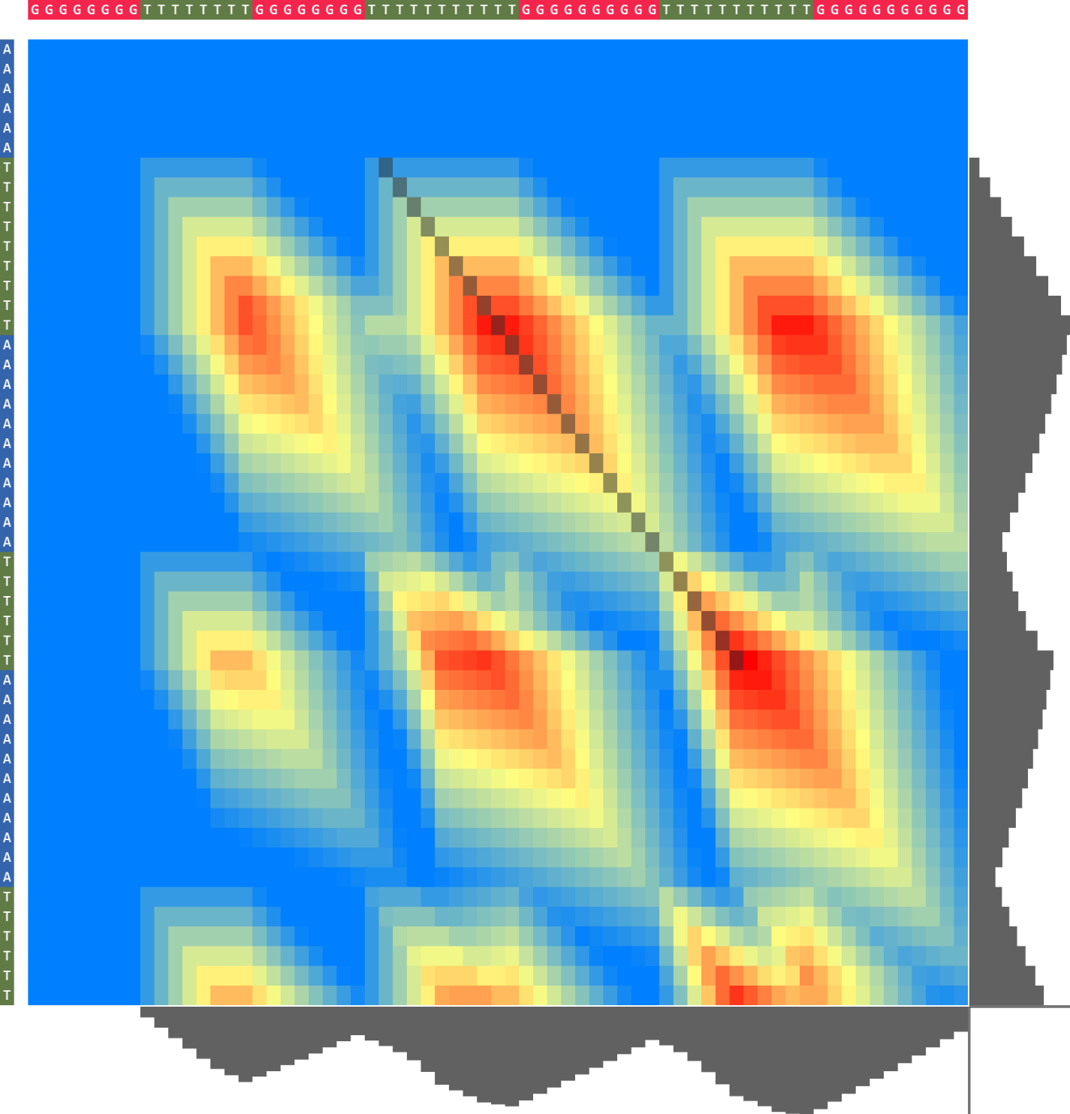
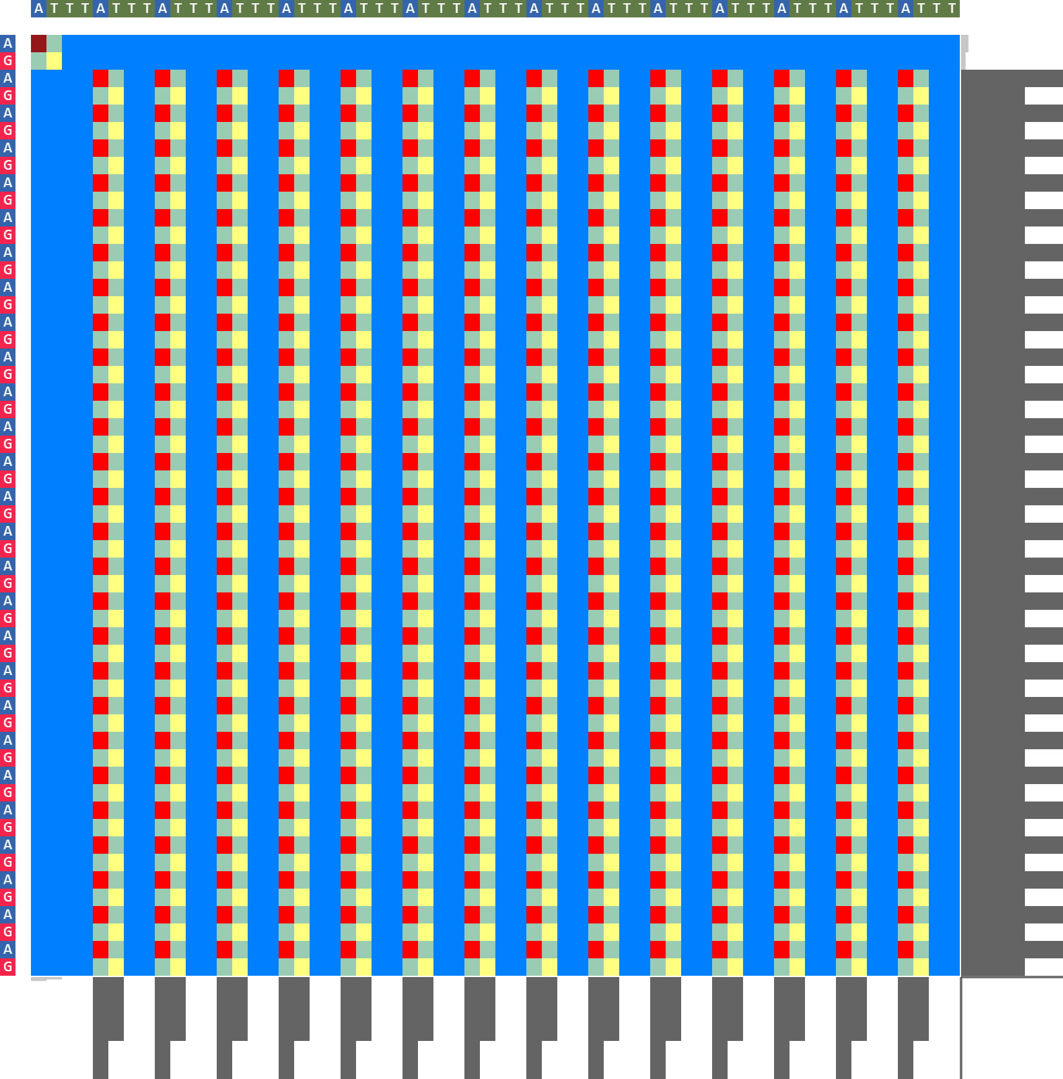
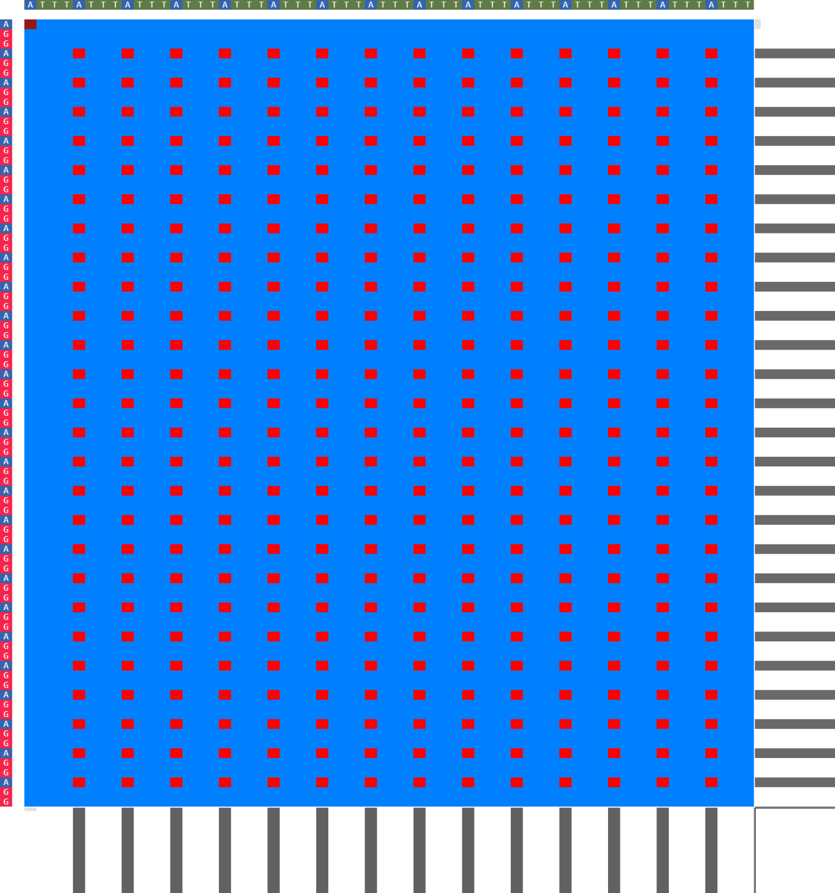
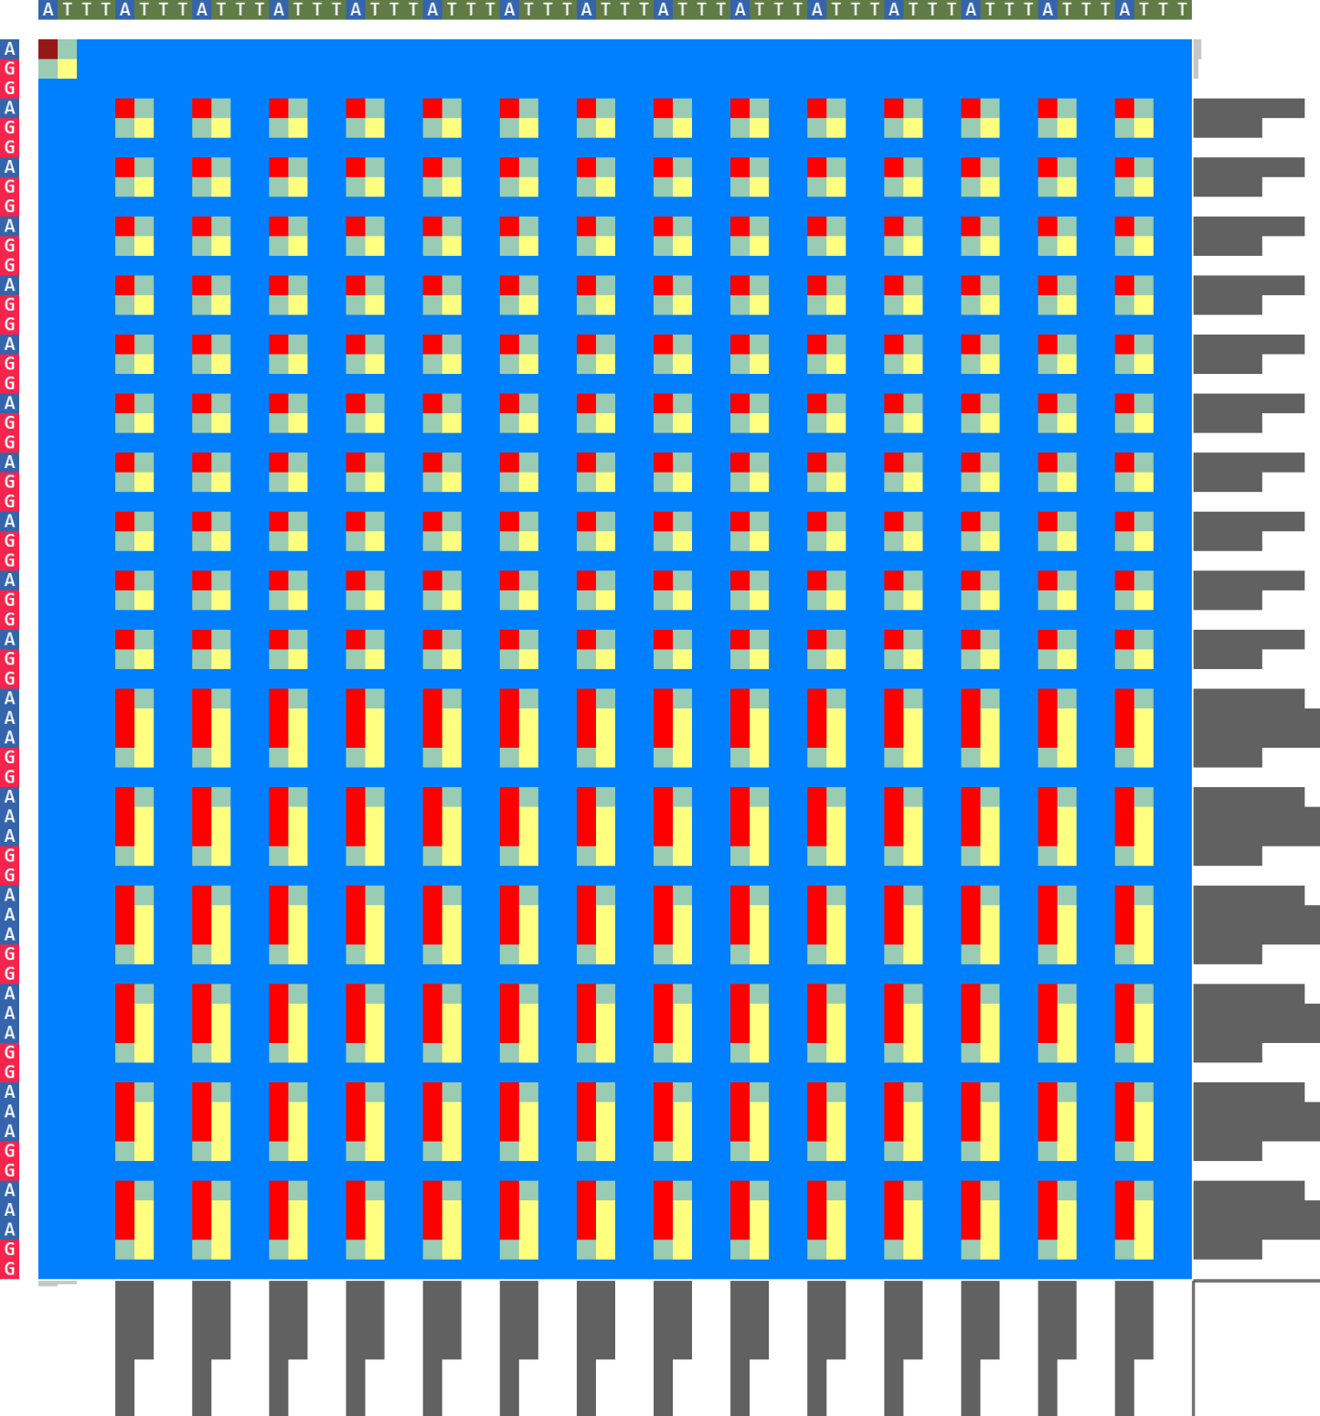
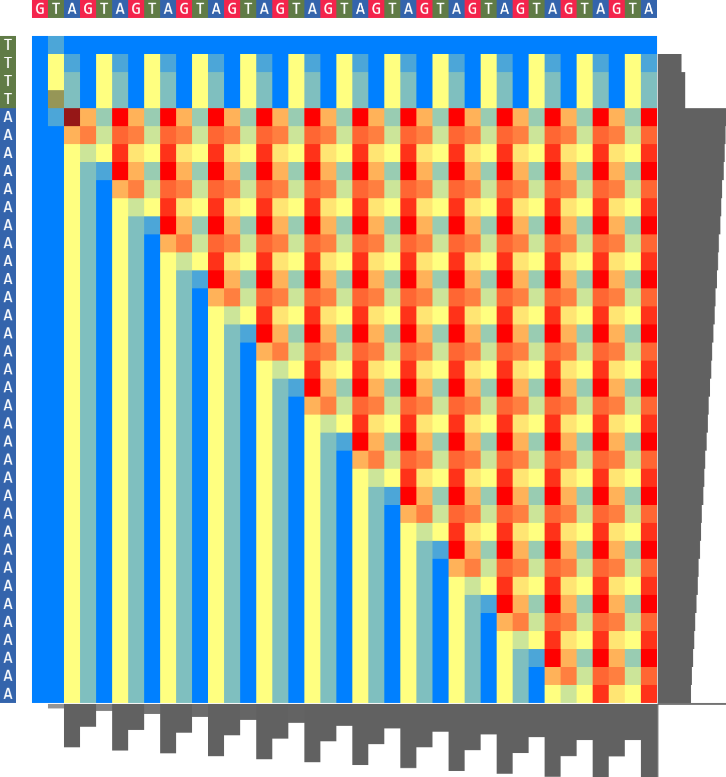
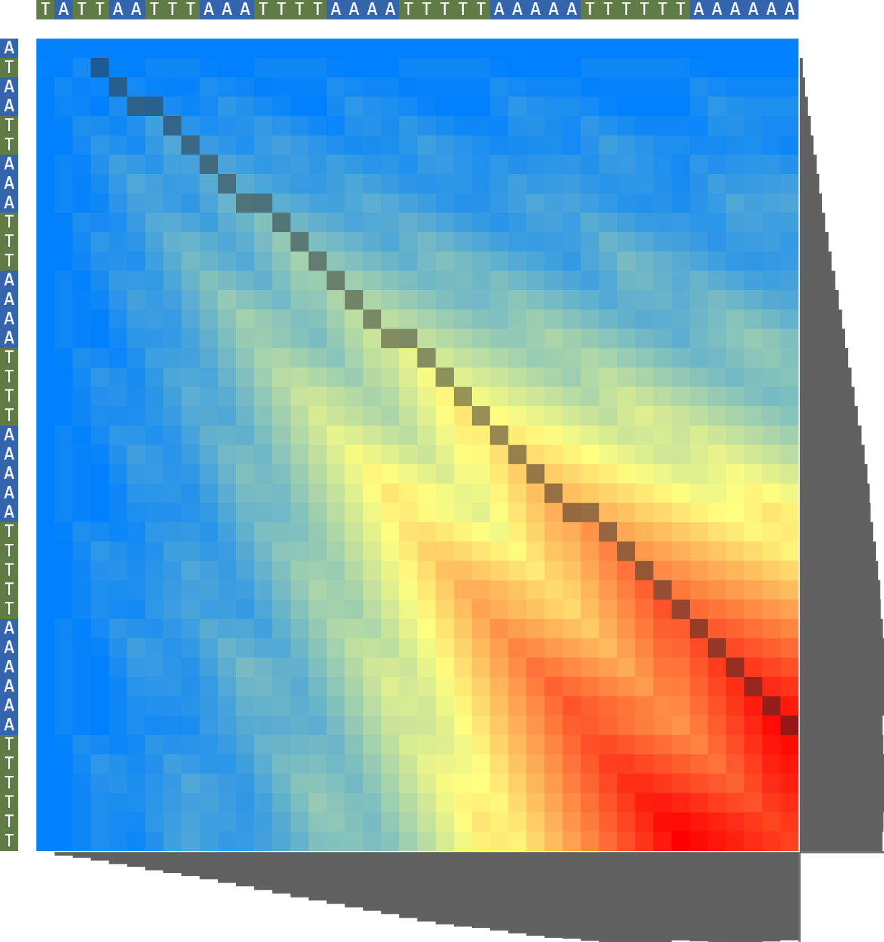
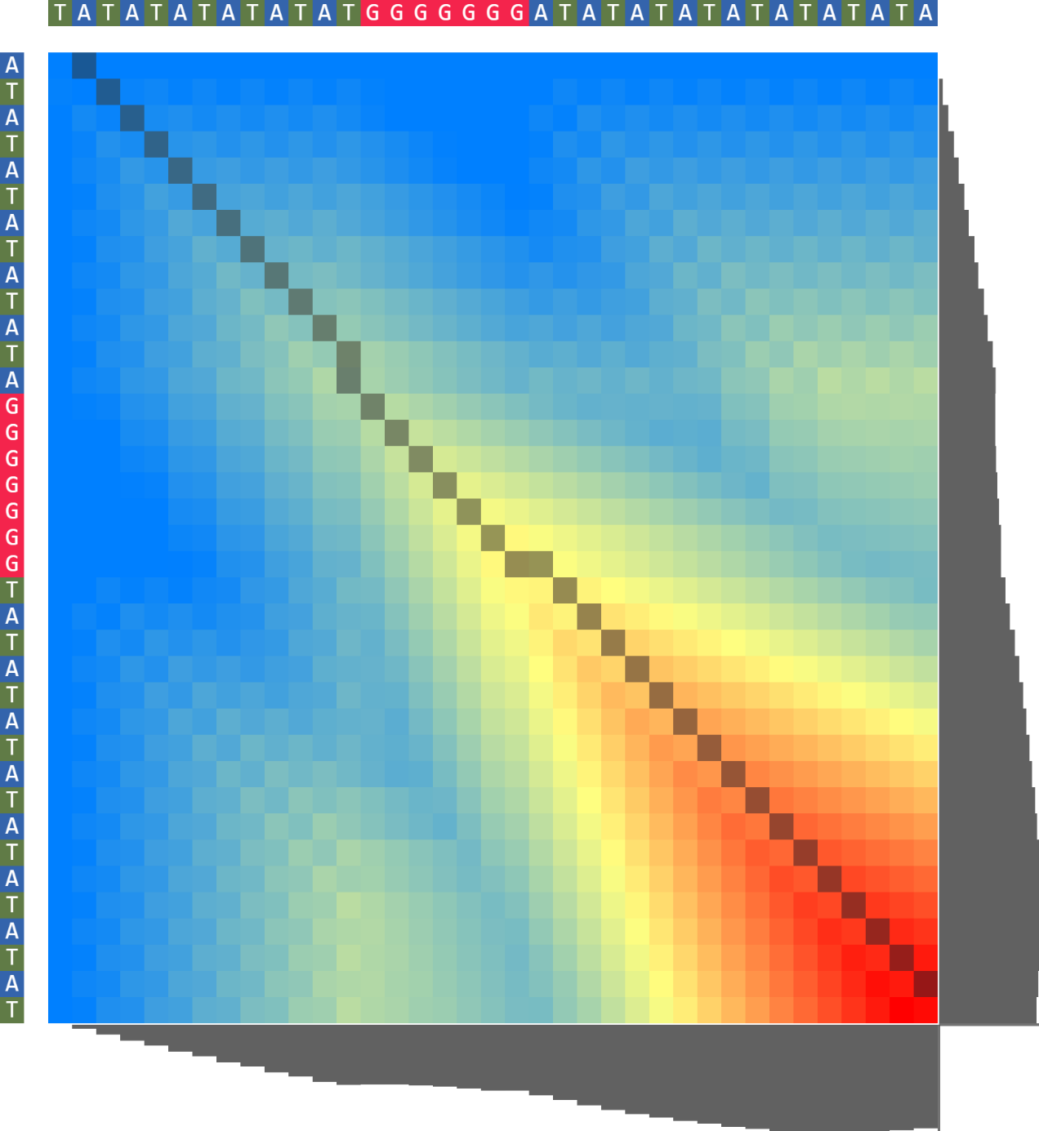
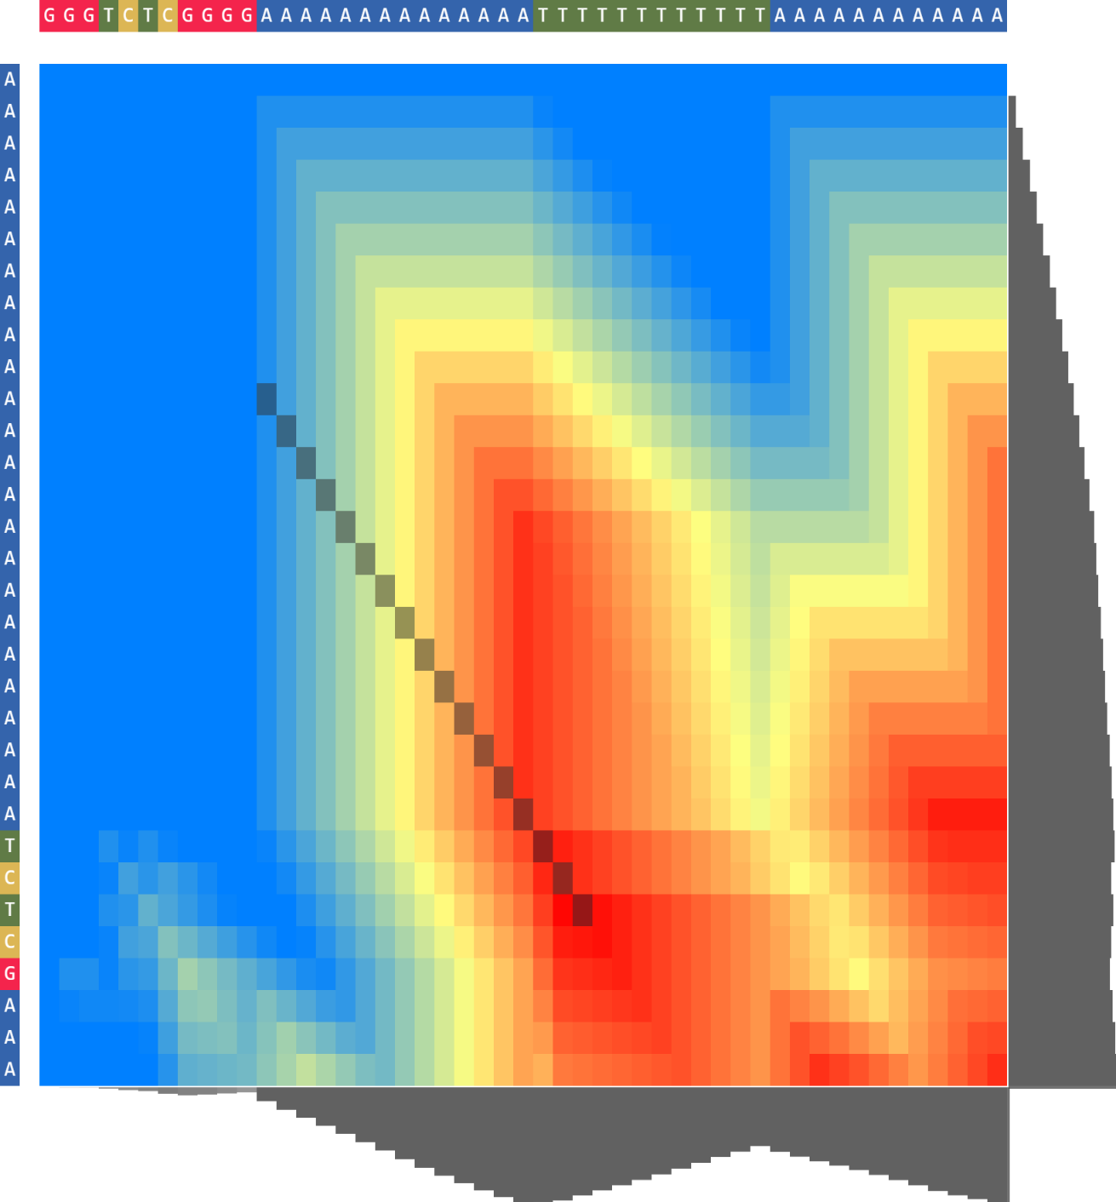
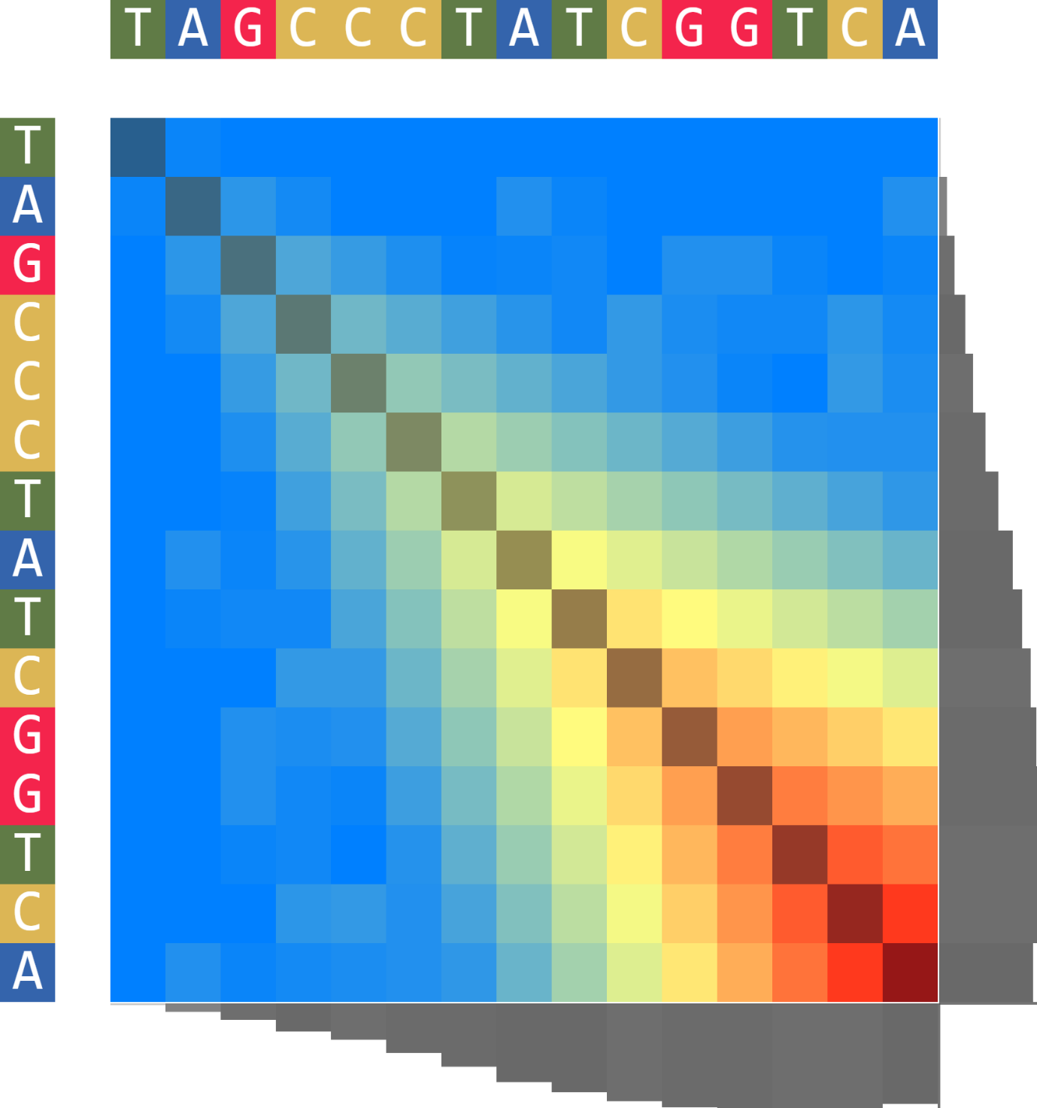


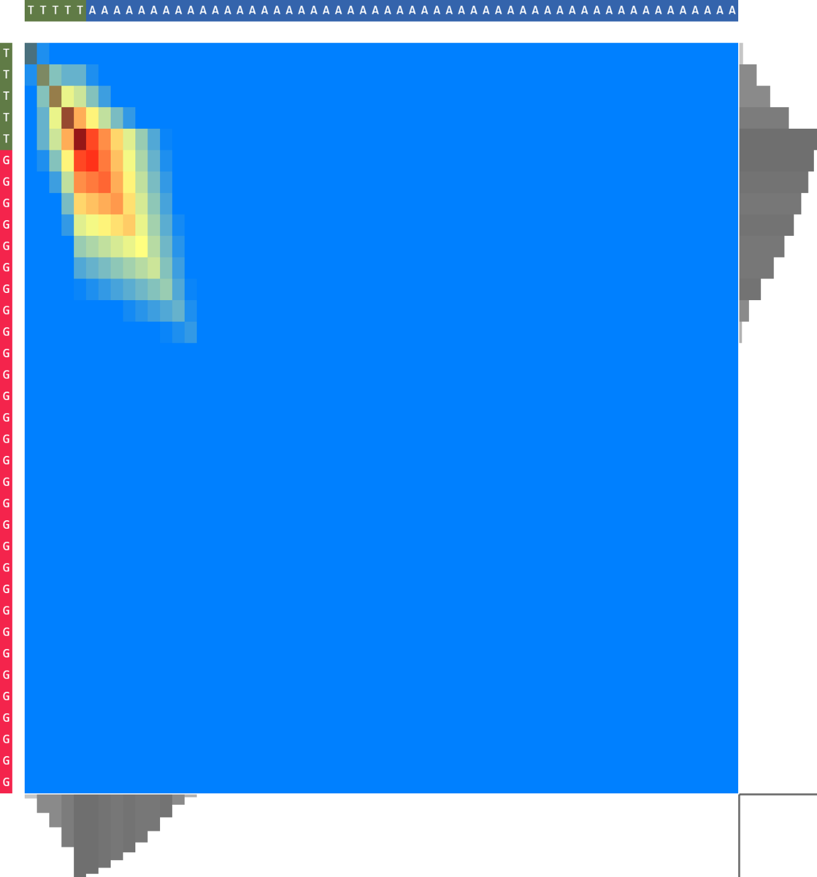

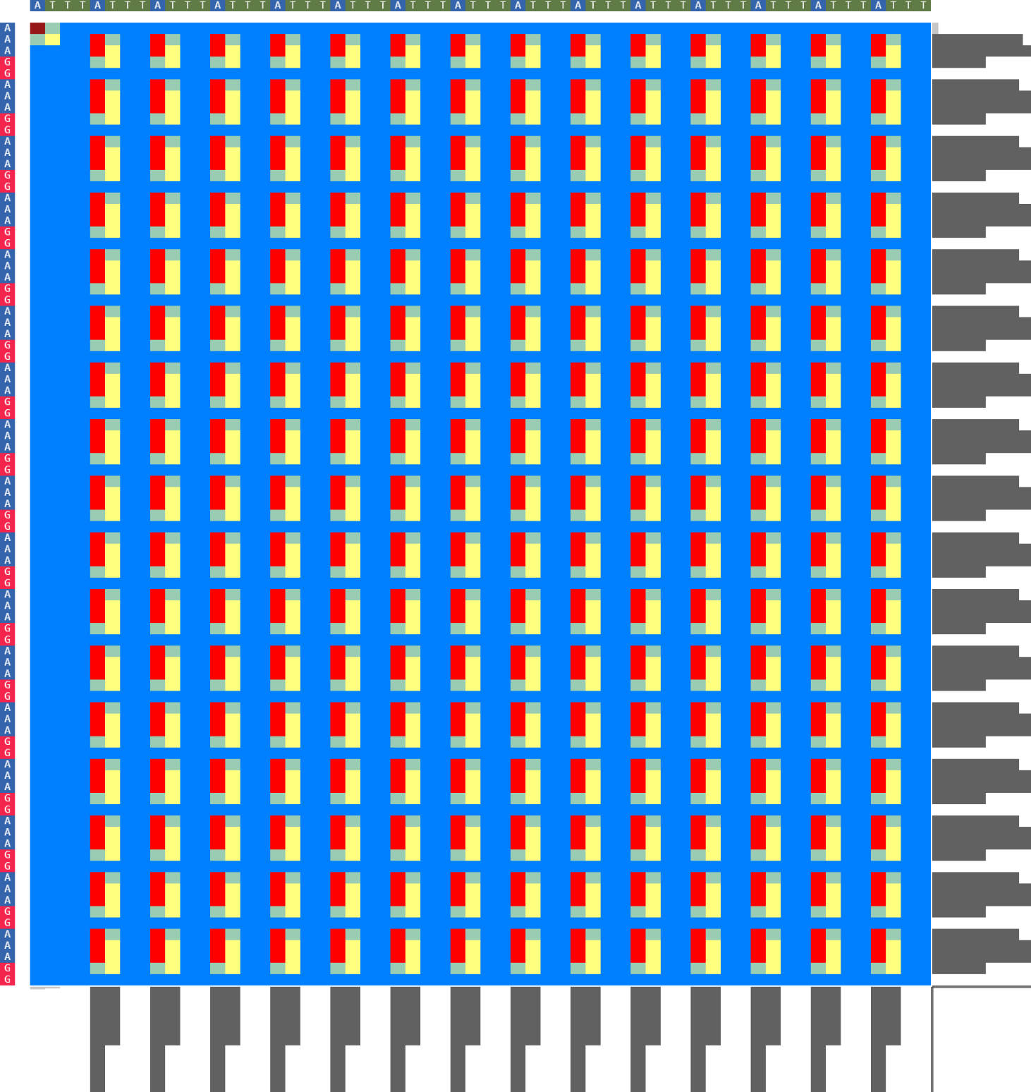
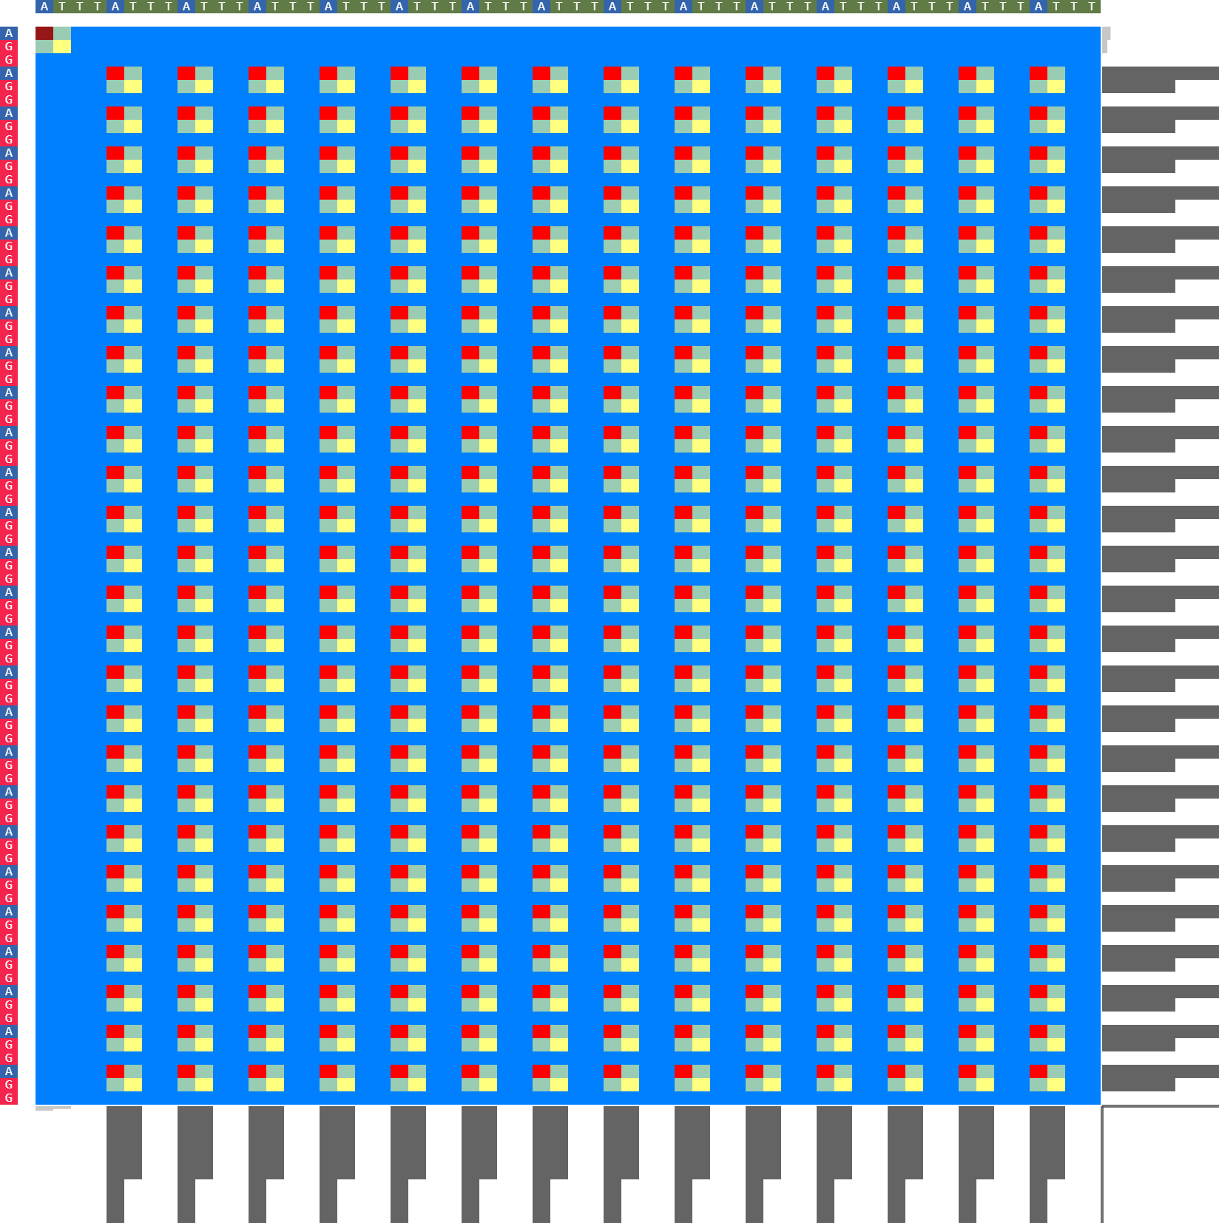

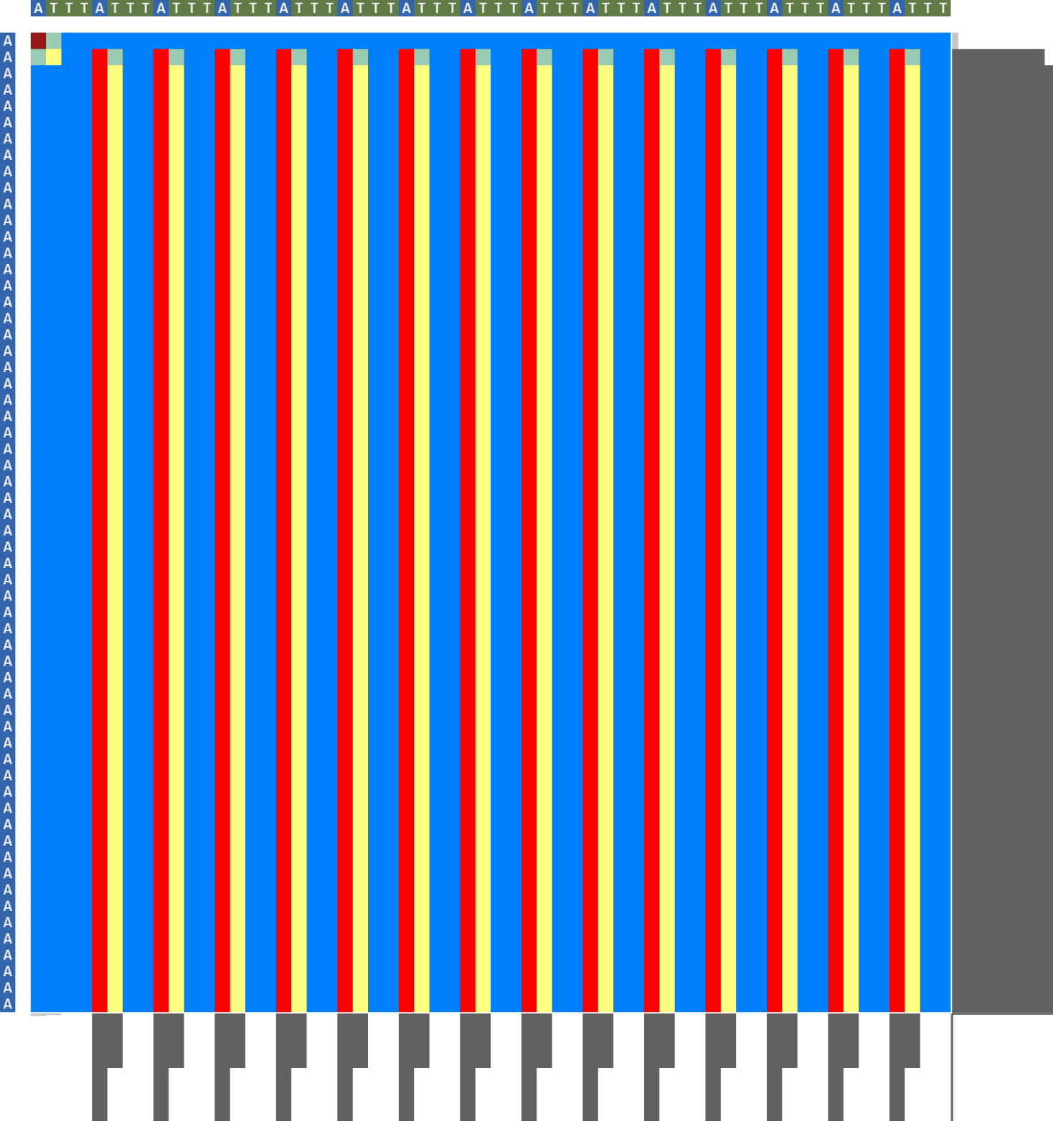
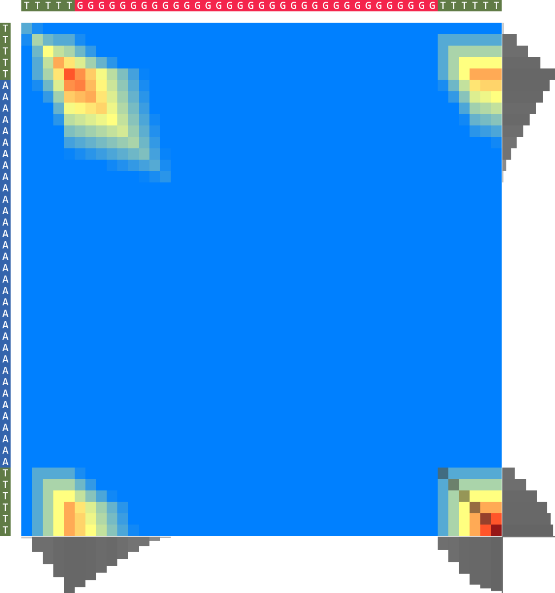
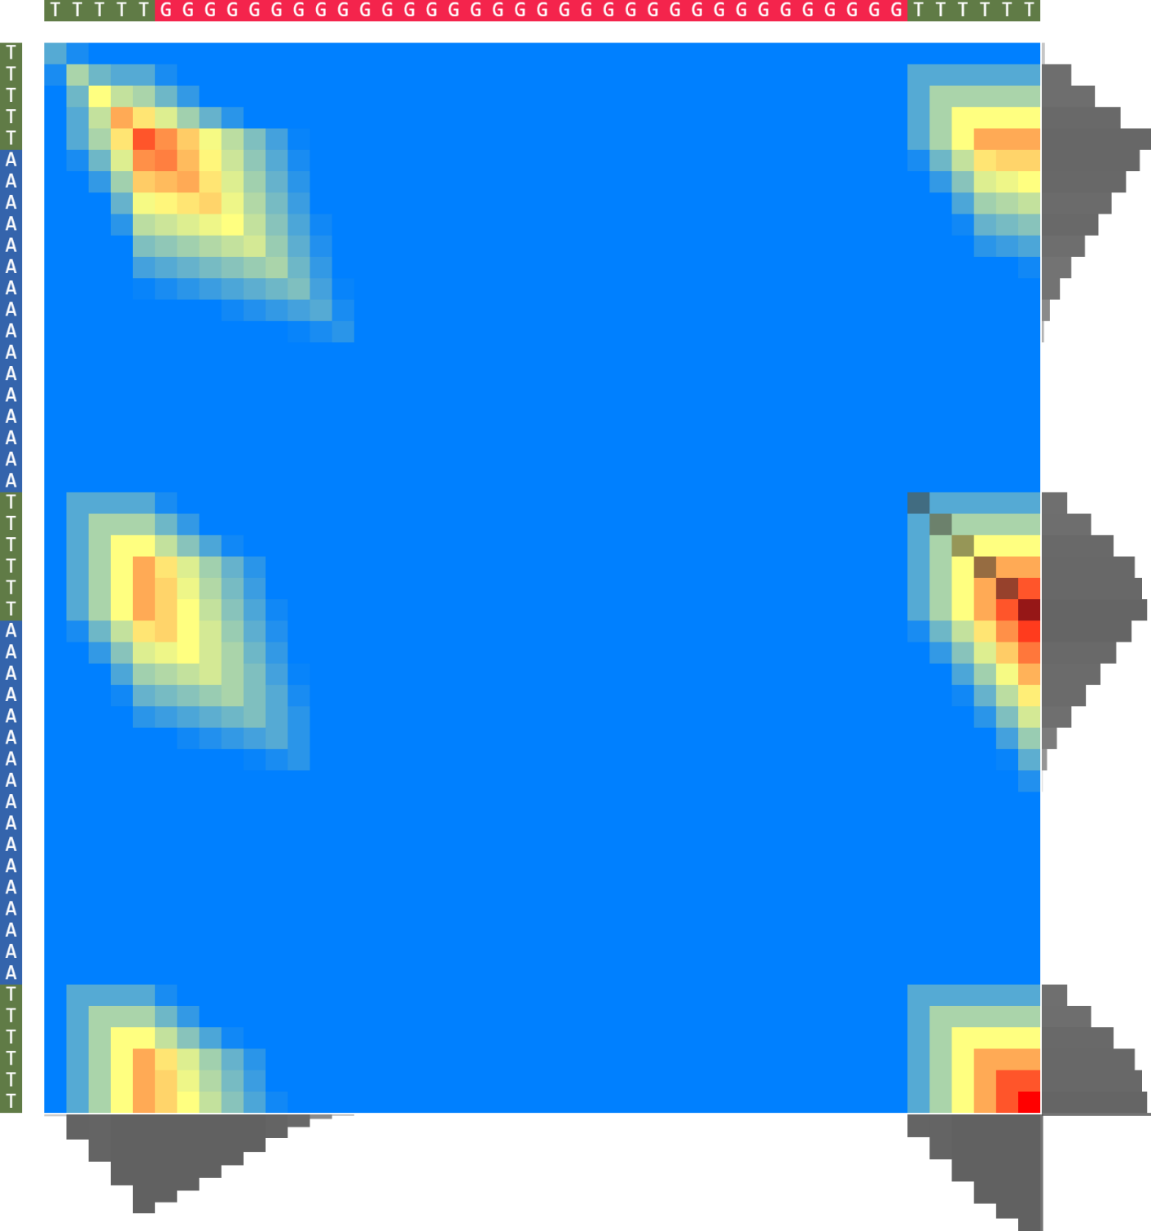
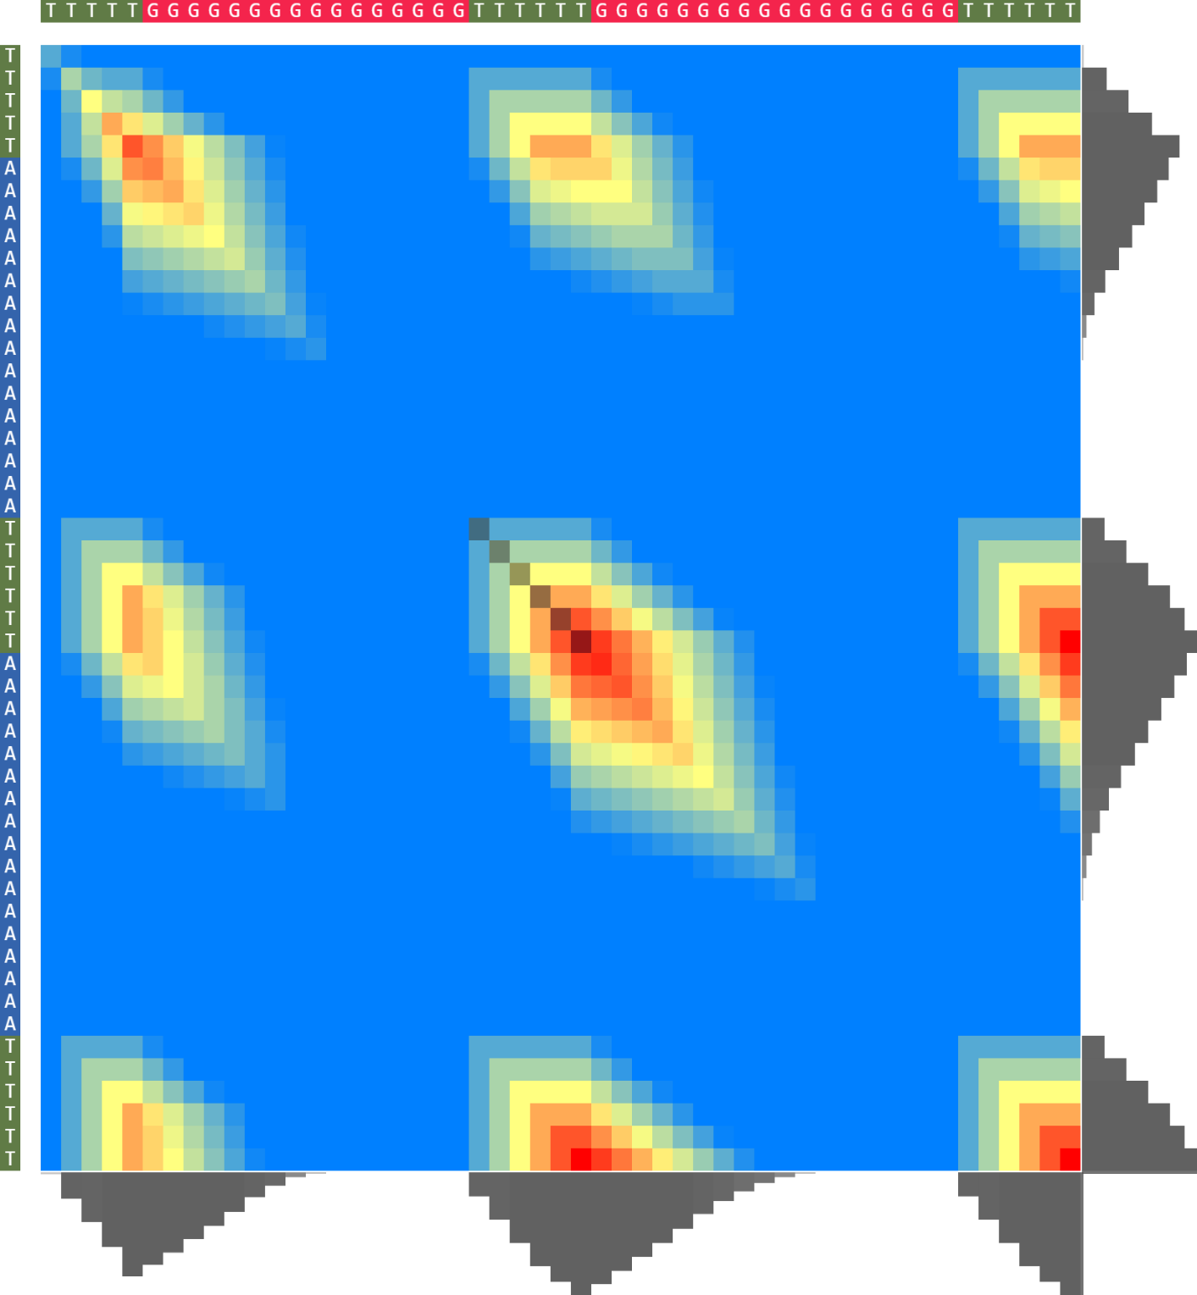
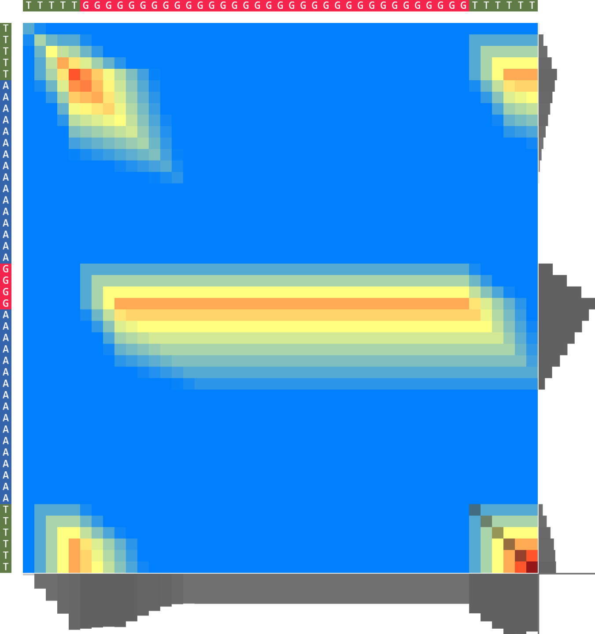
(b)
(c)
(d)
(a)
(e)
(f)
(g)
(t)
(u)
(v)
┏ 10b
5-[ ATTTTTTTTTTTTTTTTATTTTTTTTTTTTTTTTATTTTTTTTTTTTTTTTATTTTTTTTTTTTTTTT]-3
██
5-[TAAAAAAAAAAAAAAAATAAAAAAAAAAAAAAAATAAAAAAAAAAAAAAAATAAAAAAAAAAAAAAAA]-3
┗ 38b
(d)
(w)
(x)
(y)
(z)
(k)
(h)
(i)
(j)
5-[AGAG.......]-3
█
5-[ATTTATTT...]-3
5-[AGGAGG.....]-3
█
5-[ATTTATTT...]-3
5-[AGGAGG.....]-3
█
5-[ATTTATTT...]-3
5-[TTTTA─AAAAA...]-3
██ █ █
5-[ GTAGTAGTA...]-3
(aa)
(ab)
(ac)
(ad)
(l)
(m)
(n)
(o)
(p)
(q)
(r)
(s)
5-[AAAGGAAAGG...]-3
█
5-[ATTTATTT.....]-3
5-[AGGAGG.....]-3
█
5-[ATTTATTT...]-3
5-[ATTTATTT...]-3
█
5-[AAAAAAAA...]-3
5-[AAAAAAAA...]-3
█
5-[ATTTATTT...]-3

Slide 2


A score matrix dissection through specially constructed sequences
A score matrix dissection through specially constructed sequences. Each heatmap represents a score matrix. These heatmaps represent different sequence alignment configurations based on specially constructed sequences. The alignment shows that the optimal alignment area does not follow the main diagonal. (a-k) Show different patterns that can appear on the score matrix if special sequences are used. (k) Shows the symmetry present on the heatmap in the case of a perfect alignment between two sequences of the same size. (l-s) Show islands of high value numbers on the score matrix and presents the meaning of different areas on the score matrix. (t-v) shows a patterned grid.(w-ad) It shows a variety of possibilities for clean granular patterns.
Cite this work as:
Paul A. Gagniuc. Algorithms in Bioinformatics: Theory and Implementation. John Wiley & Sons, Hoboken, NJ, USA, 2021, ISBN: 9781119697961.

